Slide 1
Interfacing a wireless device with a computer
Sandeep Yerramsetty 1001156902
Dileep Kumar Budavati 1001244113
Pranav Teja Garikapati 10001276676

Slide 2
Ad-HOC NETWORKS
WANETs
Ever-changing/ubiquitous
Network Sharing
Wi-Fi networks
Devices in same Wi-Fi networks
Wi-Fi direct

Slide 3
File transfer between android device and pc
connectivity TCP-IP Socket
Using object streams
Object input stream
Object output stream
File listing/reading using Buffer reader

Slide 4
Requirements
Minimum -1.4 GHz Dual core intel/AMD processer, 2 Gb Ram, 10 Gb min free space
Android Studio for android coding
Eclipse for PC coding
Minimum required -android version 2.0 for compatibility
Framework android 2.1

Slide 5
File transfer - flow diagram
Socket connection
Button send
List of files
Select file
Sends to server
Reply from server
Storing of file

Slide 6

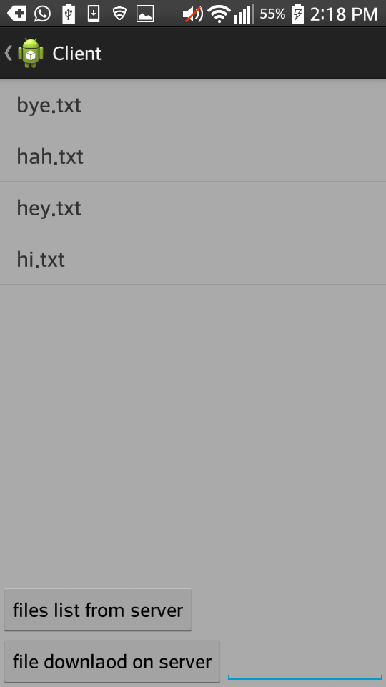
User interface of android application

Slide 7
Conclusion
There is a socket oriented transmission of data among ad hoc connected devices
We listed files of the server (PC) on client device(Android) and fetched the file data to device
Android as server file data is accessed on the PC as client file is copied to client

Slide 8
Further improvements
User interface improvements
Multiple file transfers at a time
Sorted list viewing by file types
Effective file transfer using device localization techniques
Including many more file formats including executable files, zip files, etc

Slide 9
Thank you

